Slide 1
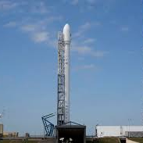
Predicting Falcon 9 First Stage Landing Success
Shahram Hakimi
August 26, 2023

Slide 2
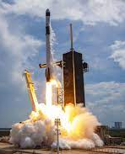
OUTLINE
Executive Summary
Introduction
Methodology Data collection
Data wrangling
EDA and interactive visual analytics
Predictive analysis
Results EDA with visualization
EDA with SQL
Interactive map with FOLIUM
Plotly Dash Dashboard
Predictive analysis (classification)
Conclusion
Appendix

Slide 3
Summary of Methodologies
The research aims to identify the crucial factors contributing to a successful rocket landing. To achieve this goal, the study employs the following methodologies:
Data Collection:
Utilization of SpaceX REST API and web scraping techniques for data gathering.
Data Wrangling:
Transformation of collected data to establish a success/failure outcome variable.
Data Exploration:
Application of data visualization techniques to explore various factors, including payload, launch site, flight number, and yearly trends.
Data Analysis:
Employment of SQL for data analysis, involving calculations of statistics such as total payload, payload range for
successful launches, and total count of successful and failed outcomes.
Launch Site Investigation:
Exploration of launch site success rates and their proximity to significant geographical markers.
Launch Site Visualization:
Visualization of launch sites with the highest success rates and successful payload ranges.
Predictive Modeling:
Construction of models for predicting landing outcomes, incorporating logistic regression, support vector machine, decision tree, and K nearest neighbor algorithms.
Results
Exploratory Data Analysis:
Observable enhancement in launch success rates over time.
KSC LC 39A emerges as the most successful landing site.
Orbits E S L1, GEO, HEO, and SSO exhibit a flawless 100% success rate.
Visualization/Analytics:
Majority of launch sites are located near the equator, with all sites
positioned close to coastlines.
Predictive Analytics:
All models demonstrate comparable performance on the test set.
.

Slide 4
Introduction
The commercial space age is democratizing space travel through companies like Virgin Galactic, Rocket Lab, Blue Origin, and notably SpaceX. Each offers unique services, from suborbital flights to satellite launches. SpaceX stands out with achievements like ISS missions, Starlink internet, and crewed spaceflights. Their cost advantage lies in reusing the first rocket stage, unlike others that are much more expensive. Forest Katsch's diagrams illustrate the significance of the first stage in Falcon 9 rockets, which is pivotal for the launch. Goal of this research is by gathering SpaceX data, building dashboards, and analyzing data, predict the first stage reuse using machine learning. This is in the pursuit of challenging SpaceX in the rocket industry.

Slide 5
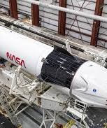
Methodology

Slide 6
Exploring SpaceX Launch Data Using specifically the SpaceX REST API and Web Scraping
Wrangling data by cleaning, transforming, and organizing raw data into a structured and usable
format for analysis.
3. One Hot Encoding and Data Cleaning: This involves preparing the data for machine learning by transforming categorical variables through one-hot encoding and addressing missing or irrelevant data.
4. Exploratory Data Analysis (EDA): Using both visualization techniques and SQL queries to understand and gain insights from the dataset's structure and patterns.
Interactive Visual Analytics with Folium and Plotly Dash: Utilizing tools like Folium and Plotly Dash to create interactive visualizations that enhance data understanding.
Predictive Analysis with Classification Models: Employing classification algorithms to predict outcomes based on input features.
Building and Evaluating Classification Models: Developing models such as Logistic Regression (LR), k-Nearest Neighbors (KNN), Support Vector Machines (SVM), and Decision Trees (DT), then evaluating their performance to identify the best model.

Slide 7
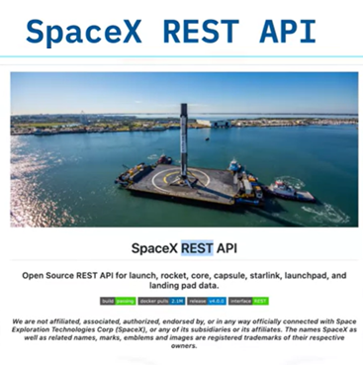
DataCollection by : API
Obtain the response and decode it using the appropriate method. Convert the decoded data into a dataframe using the .json_ function.
Use custom functions to request specific information about the launches from the SpaceX API.
Generate a dictionary from the obtained data.
Create a dataframe using the generated dictionary.
Apply a filter to the dataframe to include only launches associated with the Falcon 9 rocket.
Fill in any missing values in the Payload Mass column using a calculated method.
Export the processed data to a CSV file.

Slide 8
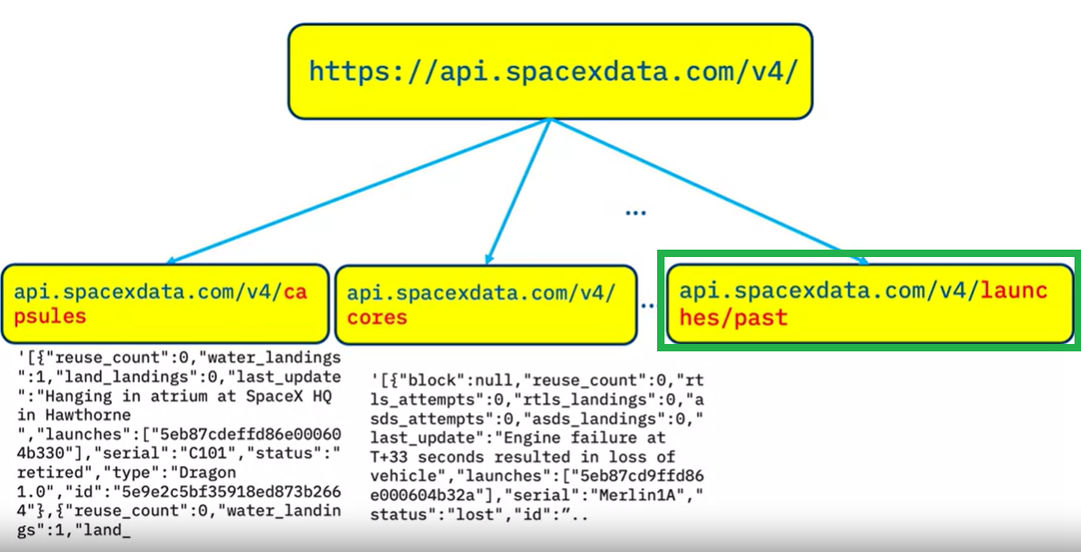

Slide 9
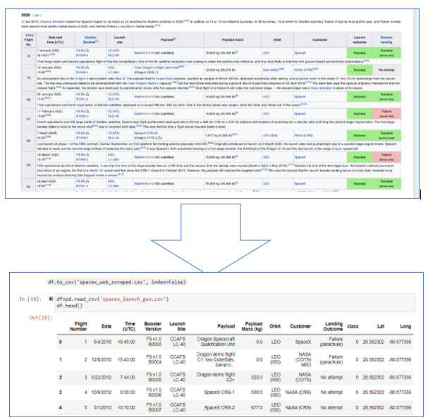
Steps for getting Data by Web Scraping
• Retrieve Falcon 9 launch data from Wikipedia.
• Generate a BeautifulSoup object from the HTML response.
• Extract column names from the header of the HTML table.
• Gather data by parsing HTML tables.
• Construct a dictionary from the collected data.
• Generate a dataframe using the created dictionary.
• Export the data to a CSV file.

Slide 10
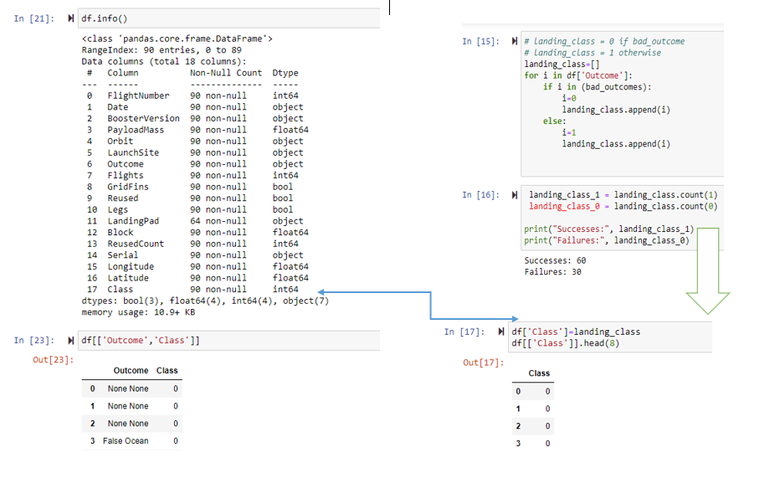
Data Wrangling
I performed some Exploratory Data Analysis (EDA) to find some patterns in the data and determine what would be the label for training supervised models.
Also defined “Class” Column to convert outcomes into Training Labels with '1' means the booster successfully landed '0' means it was unsuccessful
Then export data as a CSV file

Slide 11
EDA with Data Visualization
We first started by using scatter graph to find the relationship between the attributes such as between:
• Payload and Flight Number.
• Flight Number and Launch Site.
• Payload and Launch Site.
• Flight Number and Orbit Type.
• Payload and Orbit Type.
and find relationship by using bar charts between Class types( successful =Placed, unsuccessful =Unplaced)
orbit and Launchsite

Slide 12
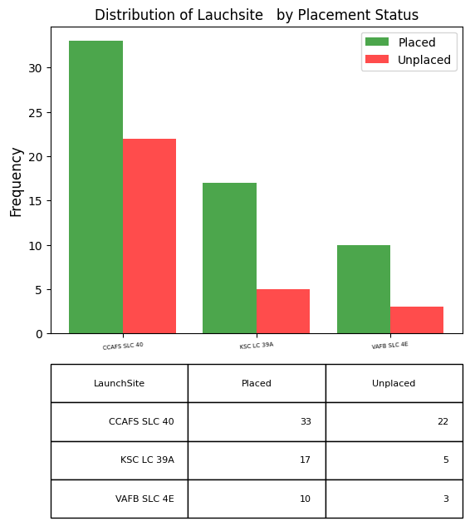
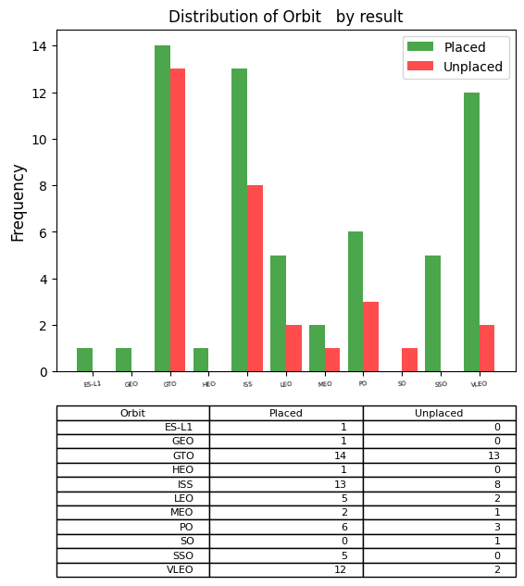

Slide 13
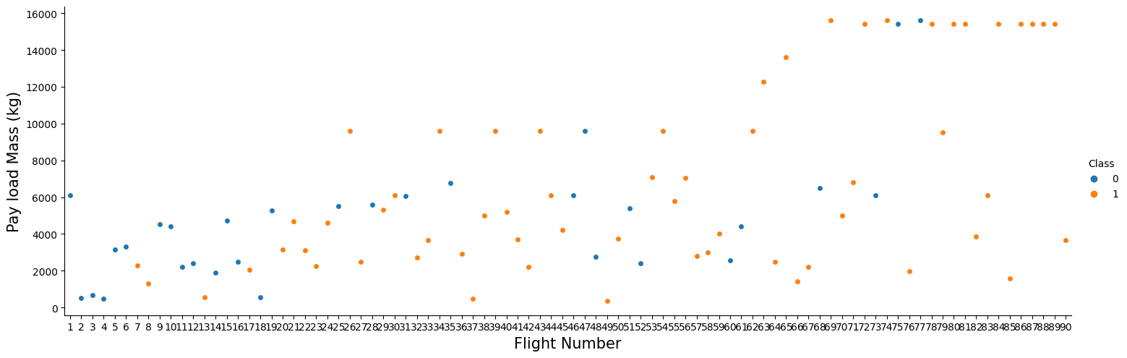
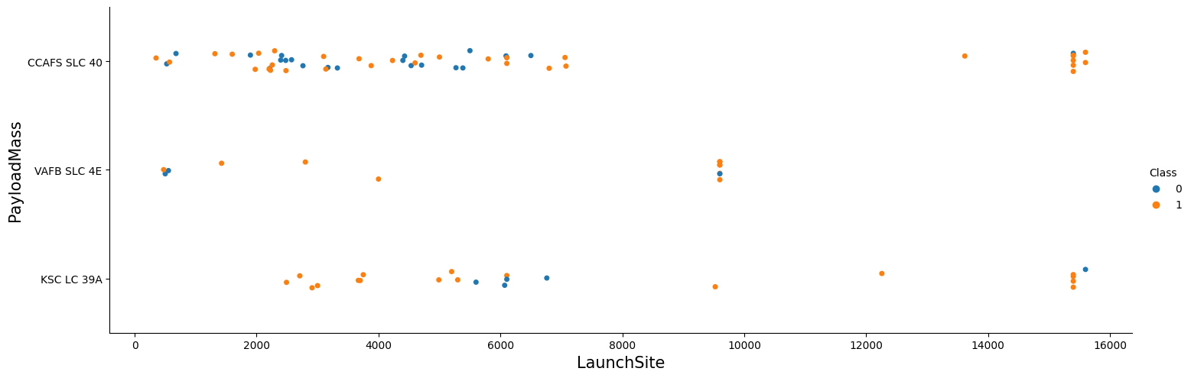
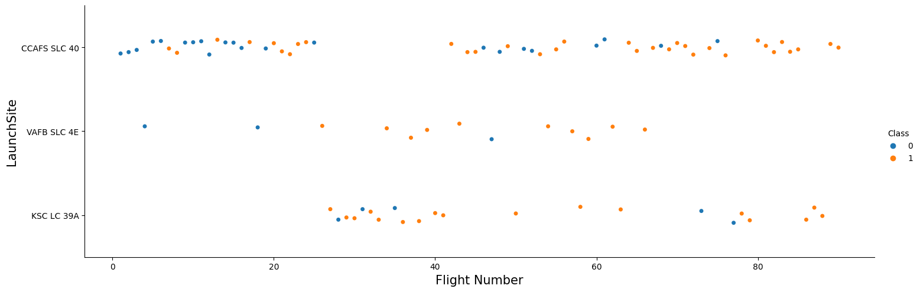
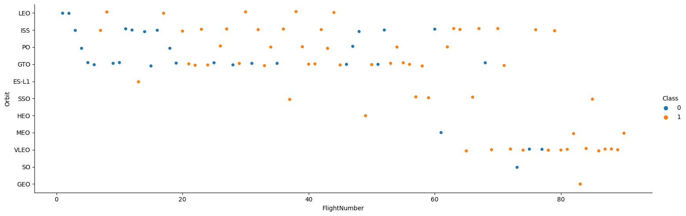

Slide 14
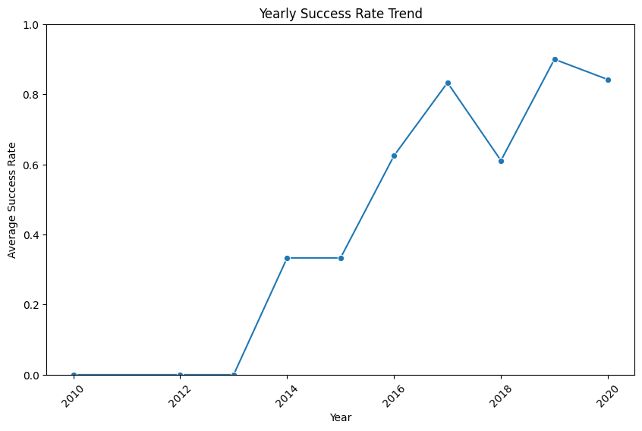

Slide 15
EDA with SQL
SQL queries performed include:-
Displaying the names of the launch sites.
Displaying the total payload mass carried by the booster launched by NASA (CRS).
45596 kg
Displaying the average payload mass carried by booster version F9 v1.1.
2928.4
-
CCAFS LC-40
VAFB SLC-4E
KSC LC-39A
CCAFS SLC-40

Slide 16
EDA with SQL
Listing the date when the first successful landing outcome in the ground pad was achieved.
First_Successful_Landing_On_Ground_Pad
2015-12-22
List the names of the boosters which have success in drone ships and have payload mass greater than 4000 but less than 6000.
F9 FT B1022
F9 FT B1026
F9 FT B1021.2
F9 FT B1031.2
Listing the total number of successful and failed mission outcomes.
Failure (in flight) 1
Success 98
Success 1
Success (payload status unclear) 1

Slide 17
EDA with SQL
Listing the names of the booster_versions which have carried the maximum payload mass.
F9 B5 B1048.4 F9 B5 B1049.4 F9 B5 B1051.3
F9 B5 B1056. F9 B5 B1048.5 F9 B5 B1051.4
F9 B5 B1049.5 F9 B5 B1060.2 F9 B5 B1058.3
F9 B5 B1051.6 F9 B5 B1060.3 F9 B5 B1049.7
Listing the failed landing_outcomes in drone ship, their booster versions, and launch site names for the year 2015.
October Failure (drone ship) F9 v1.1 B1012 CCAFS LC-40
April Failure (drone ship) F9 v1.1 B1015 CCAFS LC-40
Rank the count of landing outcomes or success between the dates 2010-06-04 and 2017-03-20, in descending order.
No attempt 10
Success (ground pad) 5
Success (drone ship) 5
Failure (drone ship) 5
Controlled (ocean) 3
Uncontrolled (ocean) 2
Precluded (drone ship) 1
Failure (parachute) 1

Slide 18
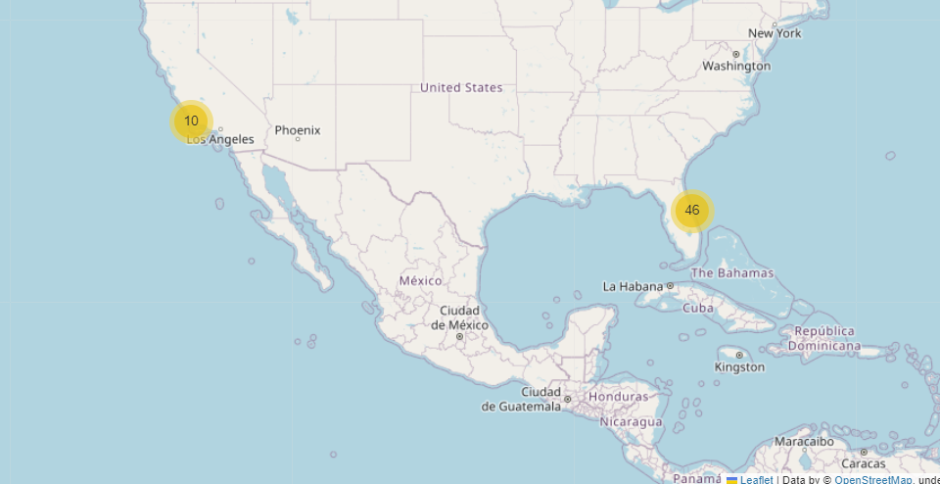
Build an Interactive Map with Folium
Marking the success/failed launches for each site on the map

Slide 19
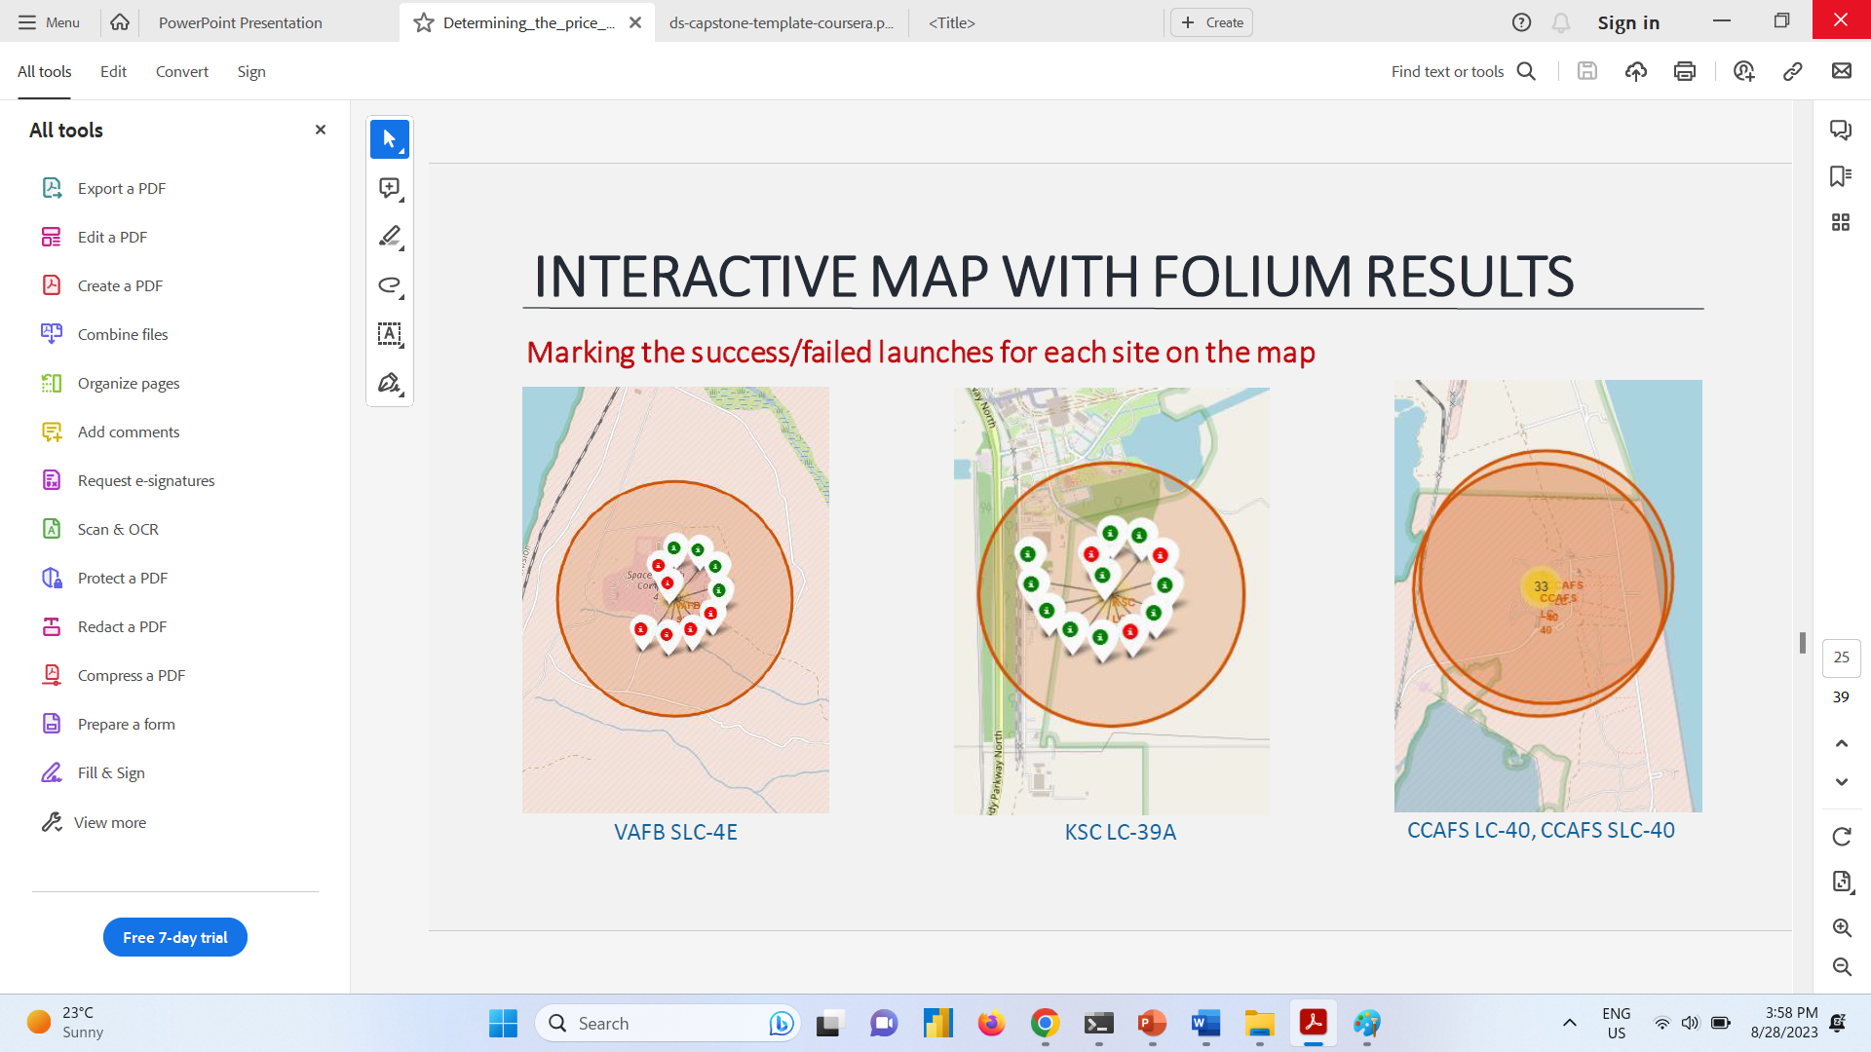
•Outcomes:
•Greenmarkersforsuccessfullaunches
•Redmarkersforunsuccessfullaunches
•LaunchsiteCCAFSSLC-40hasa3/7successrate(42.9%)

Slide 20
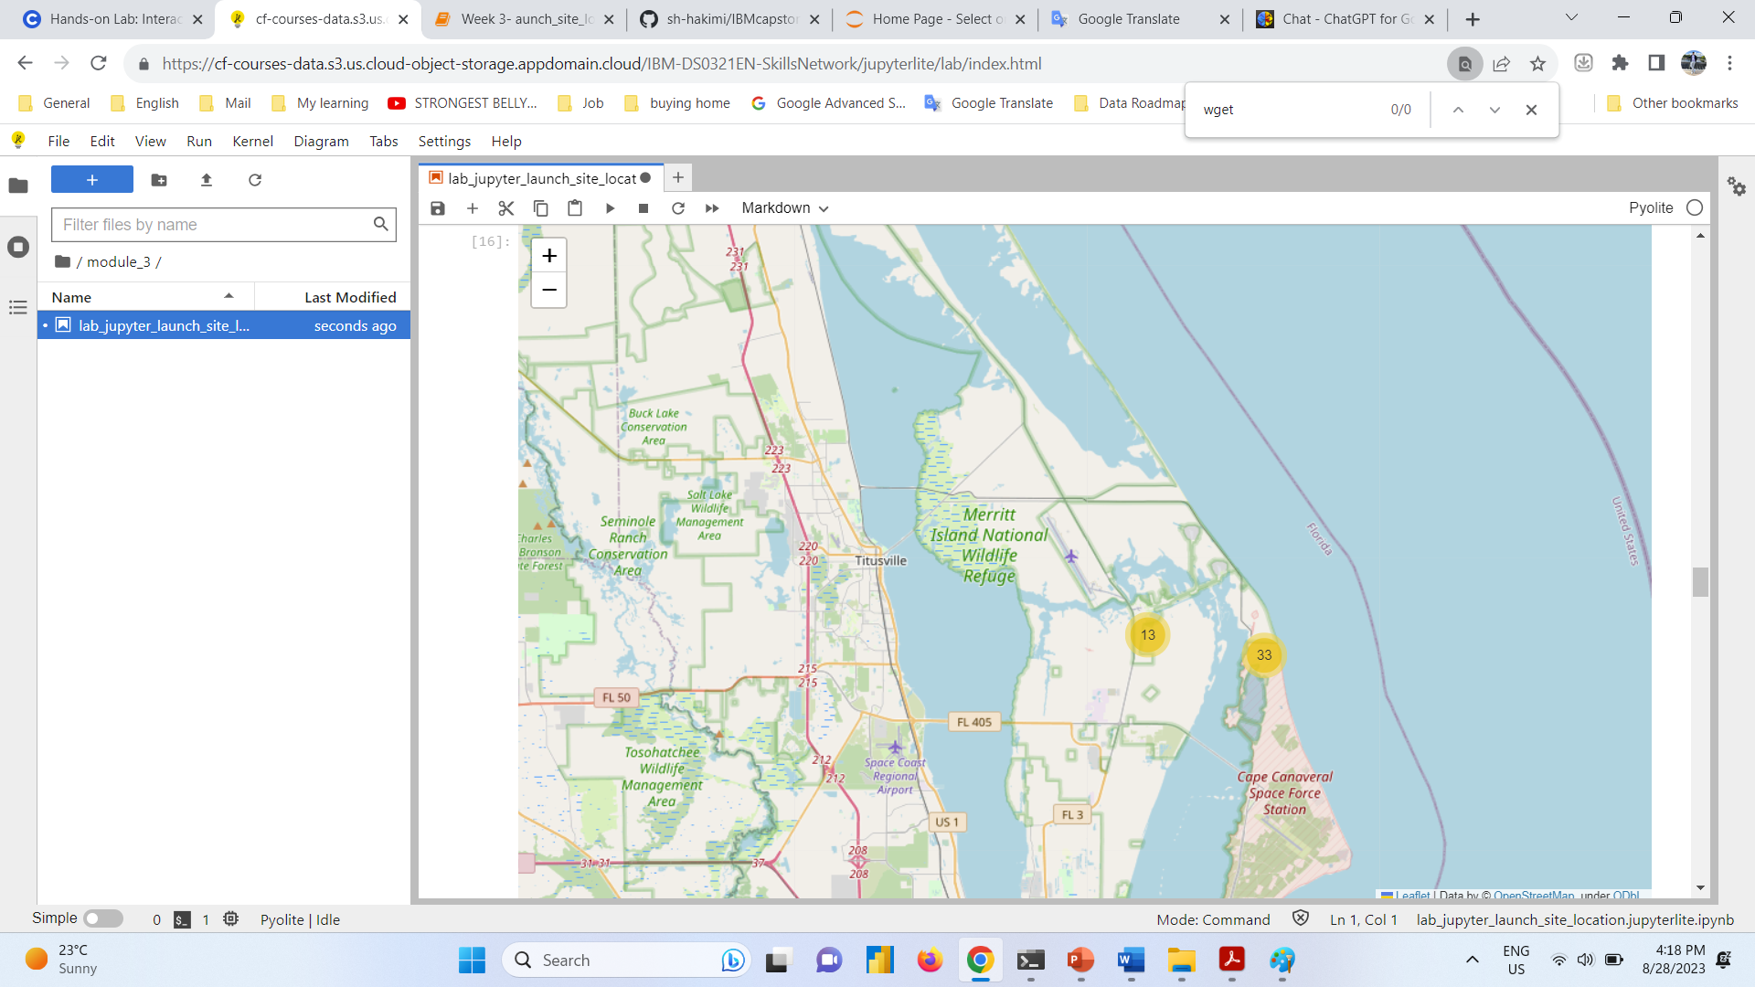
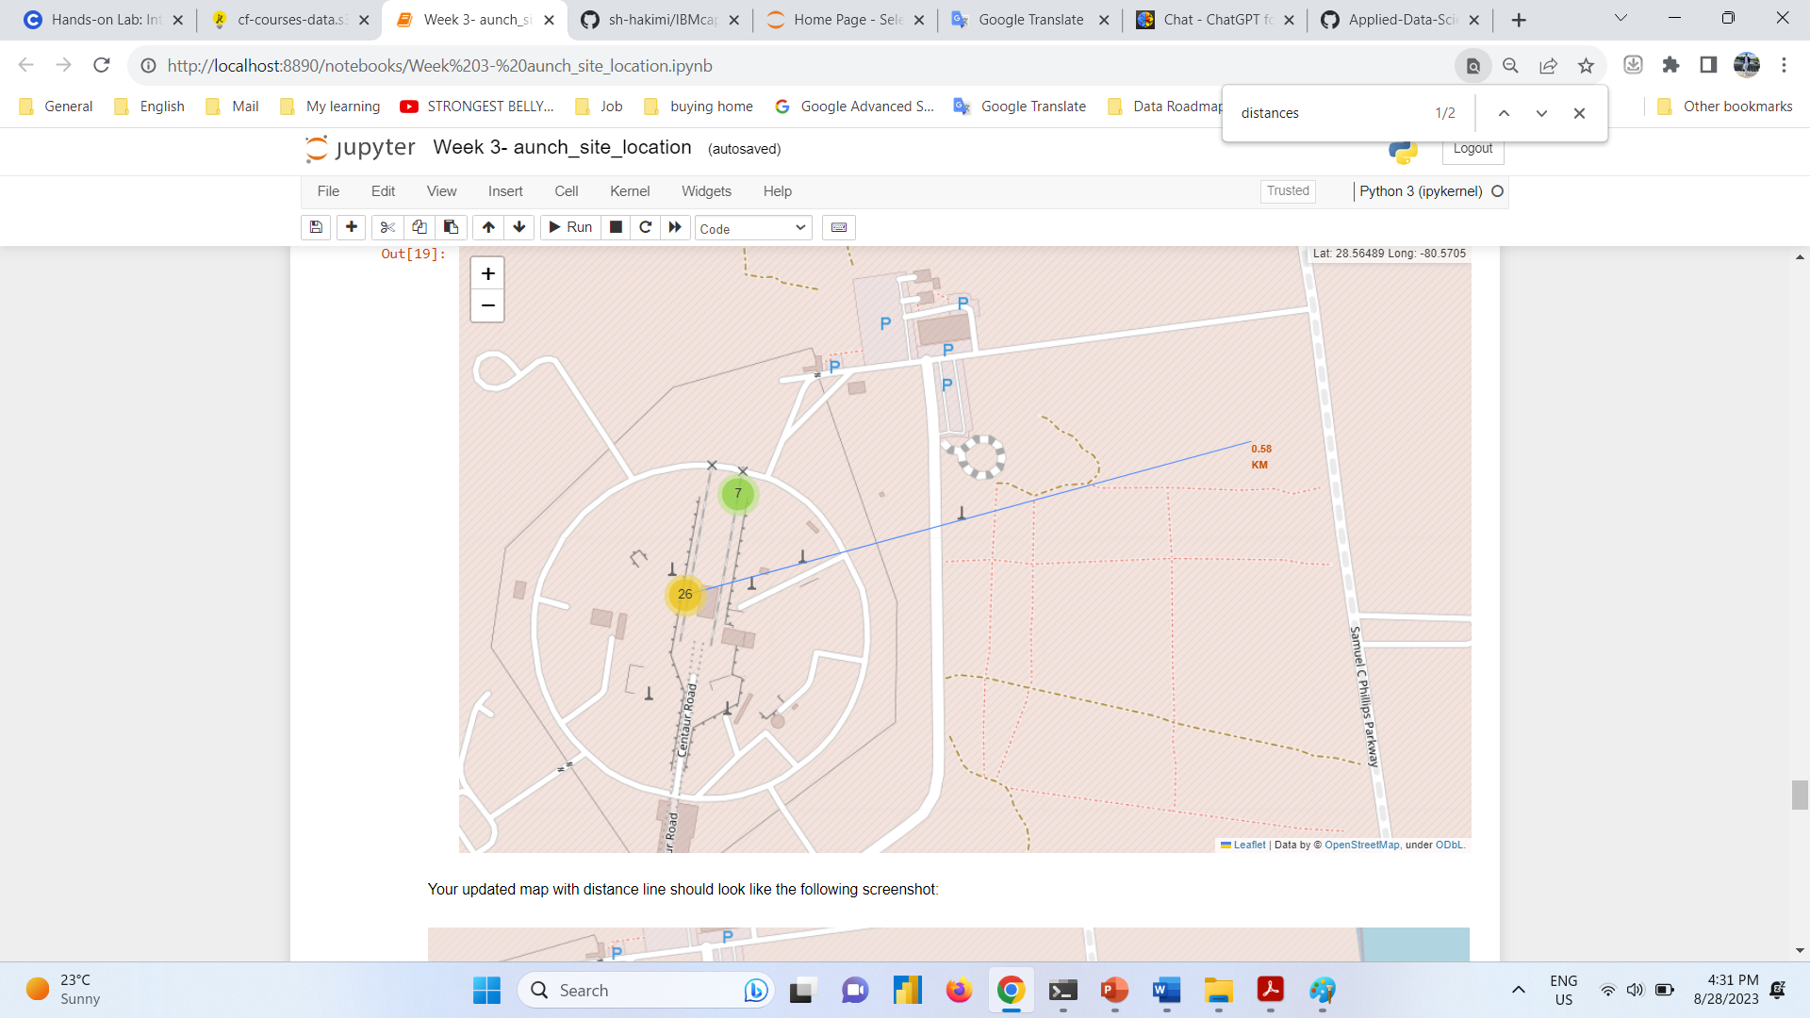
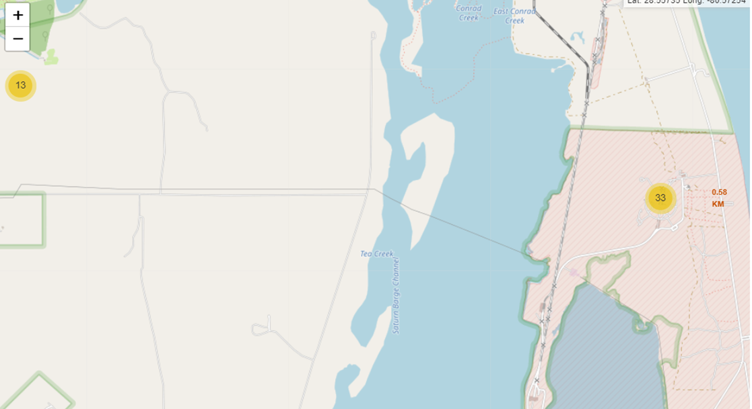
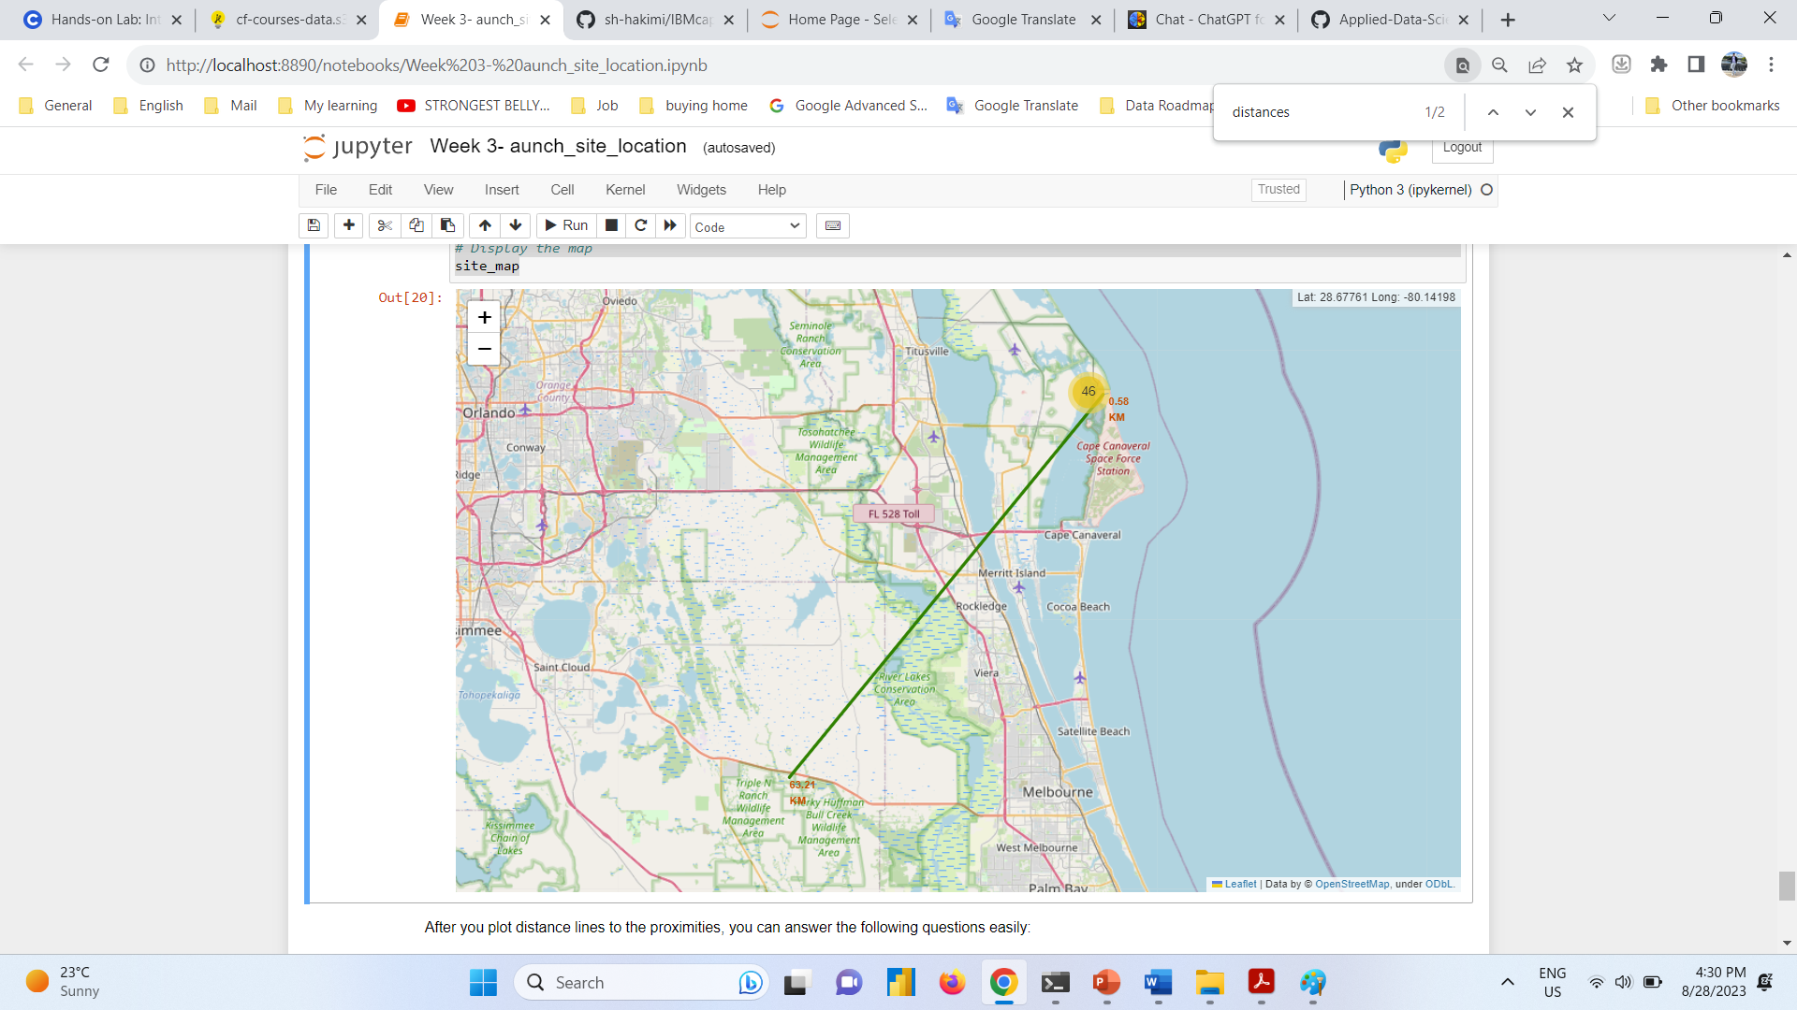

Slide 21
Calculating the proximity of each site to a coastline, railway, highway and city
The closest launch sites to a coastline are:CCAFS LC-40 andCCAFS SLC-40
All launch sites have an average proximity to a railway of 1,15 km
VAFB SLC-4E have a longest distance to a highway (8,85 km)
The launch sites farthest from city are: CCAFS LC-40,CCAFS SLC-40 andKSC LC-39A with a distance of 51,5 km. VAFB SLC-4E is closer to a city with 12,6 km.
KSC LC 39A had the most successful launches of any sites.

Slide 22
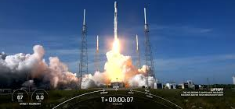
PLOTLY DASH DASHBOARD RESULTS

Slide 23
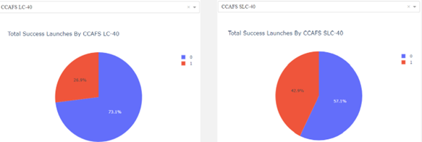
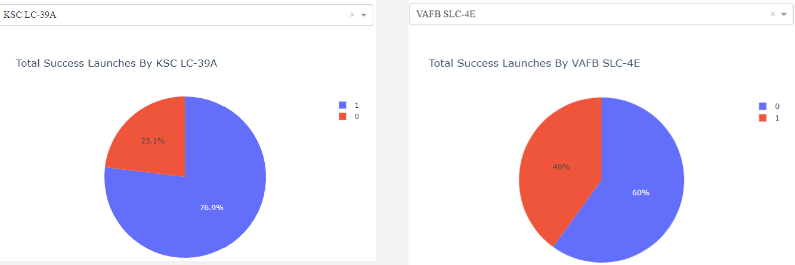

Slide 24
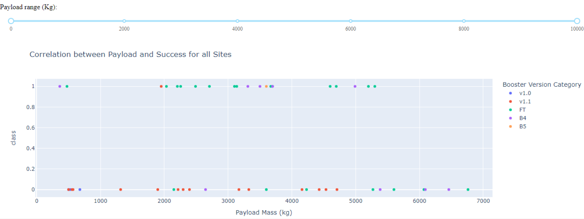

Slide 25

Machine Learning Prediction

Slide 26
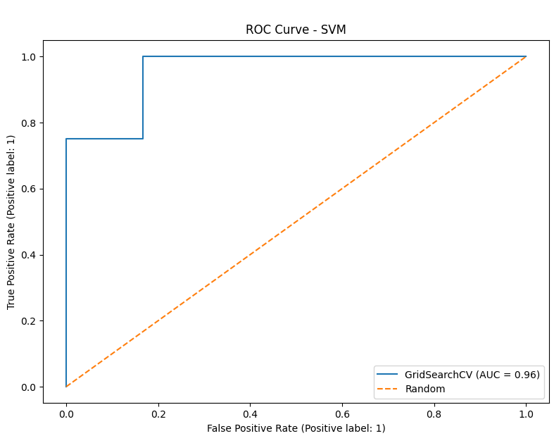
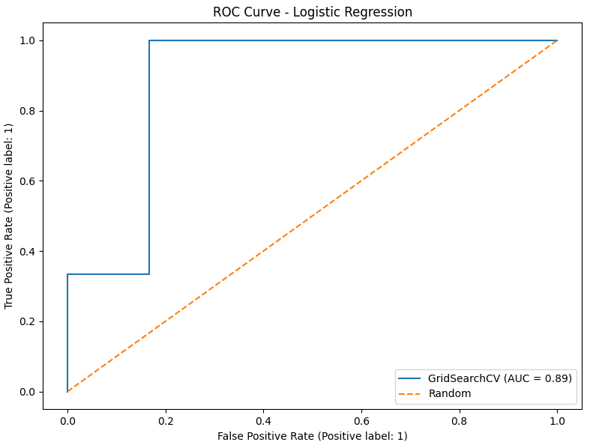
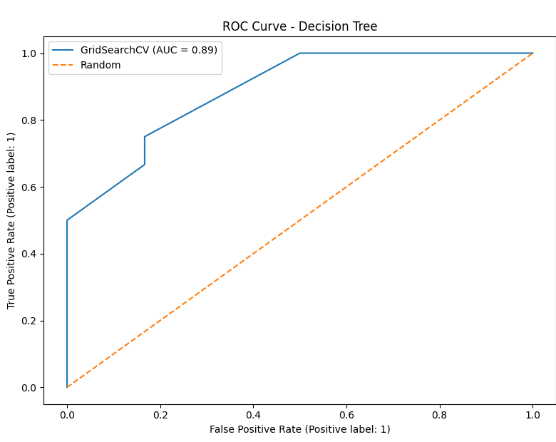
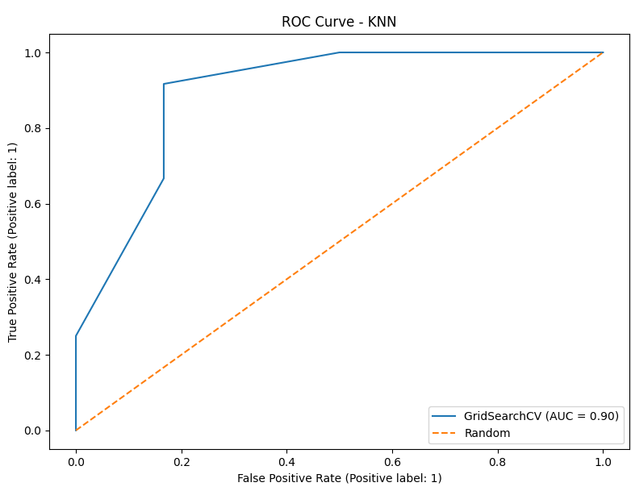

Slide 27
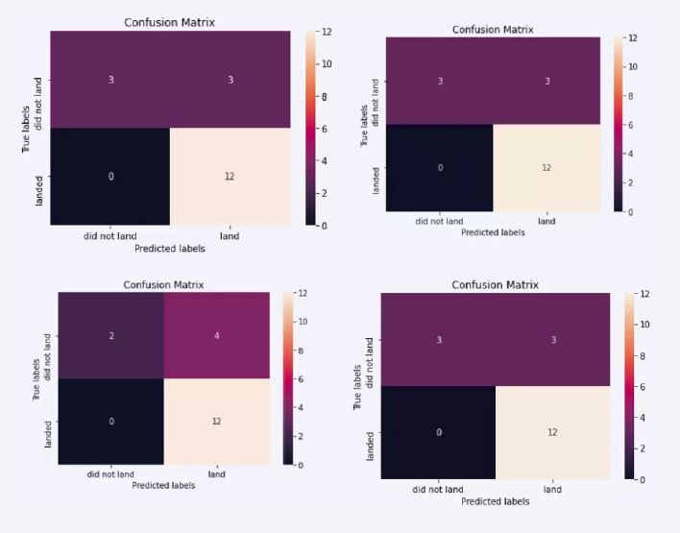
Confusion Matrix

Slide 28
The accuracy of knn_cv = 0.8333333333333334
The accuracy of decision tree_cv = 0.8333333333333334
The accuracy of SVM= 0.8333333333333334
The accuracy of Logistic Regression= 0.8333333333333334
Accuracy
All the models achieved similar performance with equivalent scores and precision. This uniformity in results is probably because of the limited dataset. Among the models, the Decision Tree slightly outperformed the others, especially when considering the best score.

Slide 29

conclusion

Slide 30
The SVM, KNN, and Logistic Regression models have superior predictive accuracy on this dataset.
Payloads with lower weights outperform their heavier counterparts.
The rate of success in SpaceX launches increases in direct proportion to the number of years taken to refine the launches.
Among all the sites, KSC LC 39A recorded the highest number of successful launches.
The Orbit categories GEO, HEO, SSO, and ES L1 demonstrate the highest rate of success.

